Slide 1
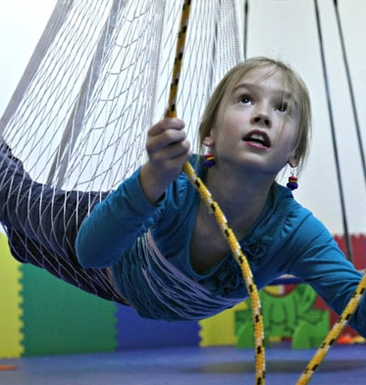
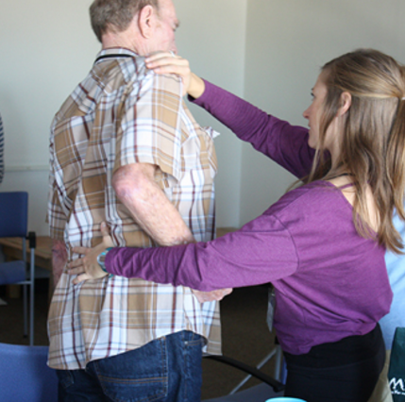

Visualization of a Research Database in Occupational Therapy Foundation and American Occupational Therapy Association
1982-2016

Slide 2
Visualization Team
introduction
For several years, the American Occupational Therapy Foundation and the American Occupational Therapy Association have built up a researcher database to track research on Occupational Therapy techniques and practices. 438 research projects have been recorded, spanning research from 1982 through 2016. The intent of this data analysis is to create a comprehensive understanding of the scientific community for building scientific networks, identifying scientific leaders for specific initiatives, and summarizing capacity to external stakeholder groups.
This report provides several visualizations of that data to provide insights to help realize this vision, and provide guidance for larger analysis of research data.
Five Visualization Types were created for this analysis:
Topical – Maps an evolving topic space using text associated with projects and researchers.
Geospatial – Presents insights on where the research is done and possible research linkages between locations.
Temporal – Shows the evolution of topics over time and where bursts of activity have occurred.
Network – Identifies networks of scientific experts and their expertise areas based on diagnosis and agenda categories presented in five cumulative time slices.
Data Explorer – Provides an on-line tool to quickly see research by location and topic areas. This will help researchers further explore and understand the insights from the other visuals provided.
Peter Annable Cincinnati, OH pannable@iu.edu
Rose Rahman Denver, CO rosrahma@iu.edu
Shahzad Saleem Minneapolis, MI saleems@iu.edu
Mahesh Suravajjala Salt Lake City, UT msuravaj@iu.edu
Helen Yezerets Columbus, IN yyezeret@iu.edu
Indiana University Information Visualization I590

Slide 3
Table of Contents
Executive Summary
Topical Visualization
Geospatial Visualization
Temporal Visualization
Network Visualization
Data Explorer
Limitations of Analysis
Problems Surfaced during Validation
Challenges and Opportunities

Slide 4
Executive Summary of Insights
Total research has grown dramatically year over year, especially after year 2000.
Seven institutions have received 80% of total funding dollars: University of Pittsburgh, Thomas Jefferson University, University of Southern California, University of North Carolina – Chapel Hill, Colorado State University, University of Buffalo and University of Texas Medical Center
While research connected Strokes is the largest overall, research related to Autism spectrum disorders has grown from none in early years to now being the top diagnosis area.
Autism research is strongly connected with Sensory Disorders. Stroke with Cerebral Palsy.
Overall there are 29 different research areas funded between 1982-2016 with an approx. funding of $153 Million. Three most researched areas are Autism, Stroke, and Sensory integration areas.
Insights are limited to current data available in the database and thus, may not be representative of the actual research status in occupational therapy.

Slide 5
Topical Analysis
Visualization Objective
To understand the most important topics researched, and connections between them.
How to Interpret
The keywords field in the OATR Data was converted to a Word Cloud. The largest words are the most mentioned in total across all research. In addition, a word co-occurence network was prepared to understand which keywords tend to occur with each other. The network map shows the top keywords by number of mentions, and the number of times they occurred together with another keyword.
Key Insights
Major groups of topics discovered during the analysis are “Stroke Rehabilitation”, “Autism”, “Sensory Processing” and “Spinal Cord Injury”.
Common topics related to “Children” are “Spinal Cord Injury”, “Autism” and “Autistic Disorder”. On the other hand, topics related to “Adults” are “Sensory Processing”, “Self-Care” and “Depression”.
Research topics found are on Stroke Rehabilitation and Early Intervention training outcome. Stroke Rehabilitation is THE major topic found throughout.

Slide 6
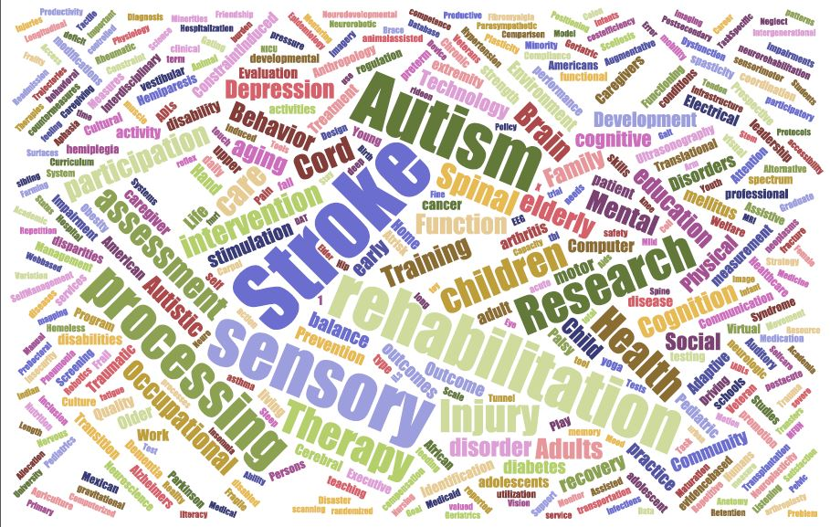
topical analysis – Word CLOUD

Slide 7
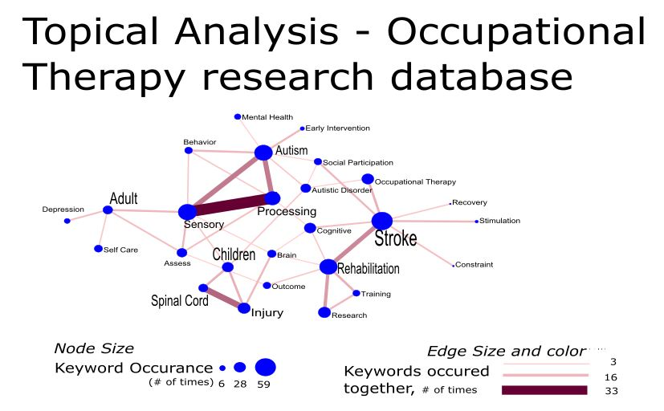
topical analysis – Keywords Network

Slide 8
Geospatial Analysis
Visualization Objective
The proportional symbol map is used to map total research activity by institution location. This provides a quick way to understand total research funding and number of projects by location, and relative ranking between institutions.
How to Interpret
Highlighted states contained at least one institution performing research. The size of the nodes represents the total funding amount from 1982 through 2016. The color of the nodes represents the number of research projects that have been conducted by the institutions. The color of the circles around the nodes represent the number of researchers within the institutions.
Key Insights
The five major players in the occupational therapy research, based on total amount of funding, are University of Pittsburgh, Thomas Jefferson University, University of Southern California, University of Chapel Hill, and Colorado State University. About 80% of total research dollars has gone to the top 7 institutions.
These five institutions also ranked highest in the number of research projects and the number of researchers.
Potential collaborations can be visually projected by identifying the size of the nodes that represent the institutions.

Slide 9
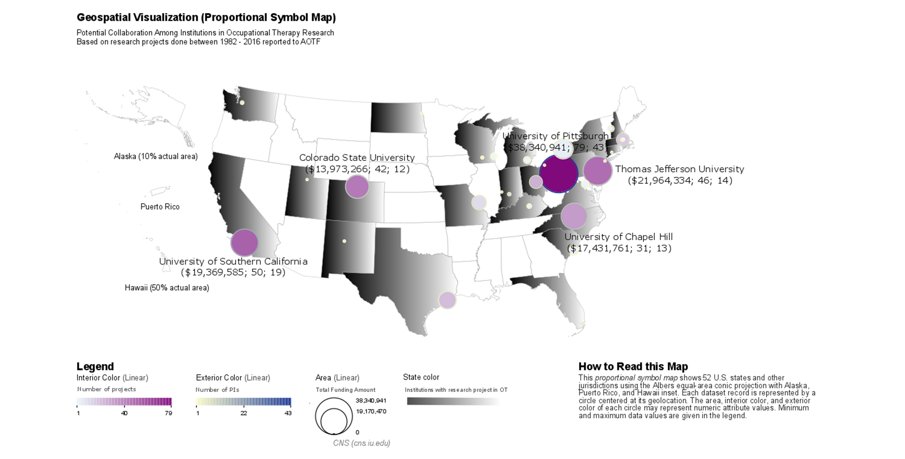

Slide 10
Temporal Visualization – Word Cloud of research projects funded over time
Visualization Objective
Main objective of temporal analysis is to highlight the diagnosis descriptions funded by AOTF over a period of time. Temporal analysis helps visualize the breadth and length of investments in various fields during different time periods.
How to Interpret
Diagnosis description for each project has been highlighted in different color
Research projects have been time sliced into 4 decades (80’s, 90’s, etc..)
Heading for each decade highlights the total number of research projects funded, and approximate funding amount for that period
Size of diagnosis description highlights the number of different projects covering this diagnosis topic during this decade
For the sake of better analysis, “Others” will not be used in explaining key insights from these visualizations.

Slide 11
Temporal Visualization – Word Cloud of research projects funded over time
Key Insights
During 1980’s & 1990’s, Amputation related research projects have been funded the most. During 1990’s, Sensory processing disorders related projects have also been equally encouraged by AOTF.
AOTF funded projects have increased by 4 times from 1980’s to 90’s, while the funding amount increased from $1.12 Mil to $30.1 Mil during this period.
During 2000’s – Autism related research projects have been funded the most, followed by Heart stroke related projects. There were a total of 272 different research areas covered during this decade, and close to $64.7 Mil of funding granted (almost of twice the amount funding compared to 1990’s).
During 2000’s, Amputation and Sensory related research projects have slowly started coming down. This can be attributed to lower such cases reported in general, while Autism and Heart related issues would have been more prevalent.
New research areas funded the most during 2000’s – Orthopedics and Neurodegenerative diseases.
After 2010, Autism and Heart related research projects have still been the most AOTF funded research areas. Breadth of diagnosis areas covered has widened quite a bit.
There is a total of $57.8 Mil funding provided between 2010 and 2016.
New research areas funded during this time are – Burns and HIV/AIDS.
Overall there are 29 different research areas funded between 1982-2016 with an approx. funding of $153 Million. Three most researched areas** are Autism, Stroke, and Sensory integration areas.
**based on number of projects and not funding

Slide 12
Temporal Visualization Word Cloud of research projects funded over time

Slide 13
Temporal Visualization – Burst analysis of research projects funded over time
Visualization Objective
Main objective of burst analysis is to highlight the consistent persistence or longevity of various research areas funded by AOTF over a period of time. Burst analysis helps to visualize how persistent AOTF has been with a particular research area over a period of time.
How to Interpret
Diagnosis descriptions are normalized/tokenized. Each research type is color coded separately
Graph highlights what topics have been persistently funded during various time periods
Area of the bar highlights number of different research projects conducted on that topic
Only persistently sponsored diagnosis areas have been highlighted
Key Insights
Alzheimer and Amputation have been persistently sponsored over the first two decades
Sensory Integration and Cerebral Palsy areas have been funded consistently during 1990’s and early 2000’s
As more and more research areas are funded, there are very limited diagnosis areas that are consistently funded
A large of number of projects in Autism area have been funded in 2007. [Higher the area, more the number of projects]

Slide 14
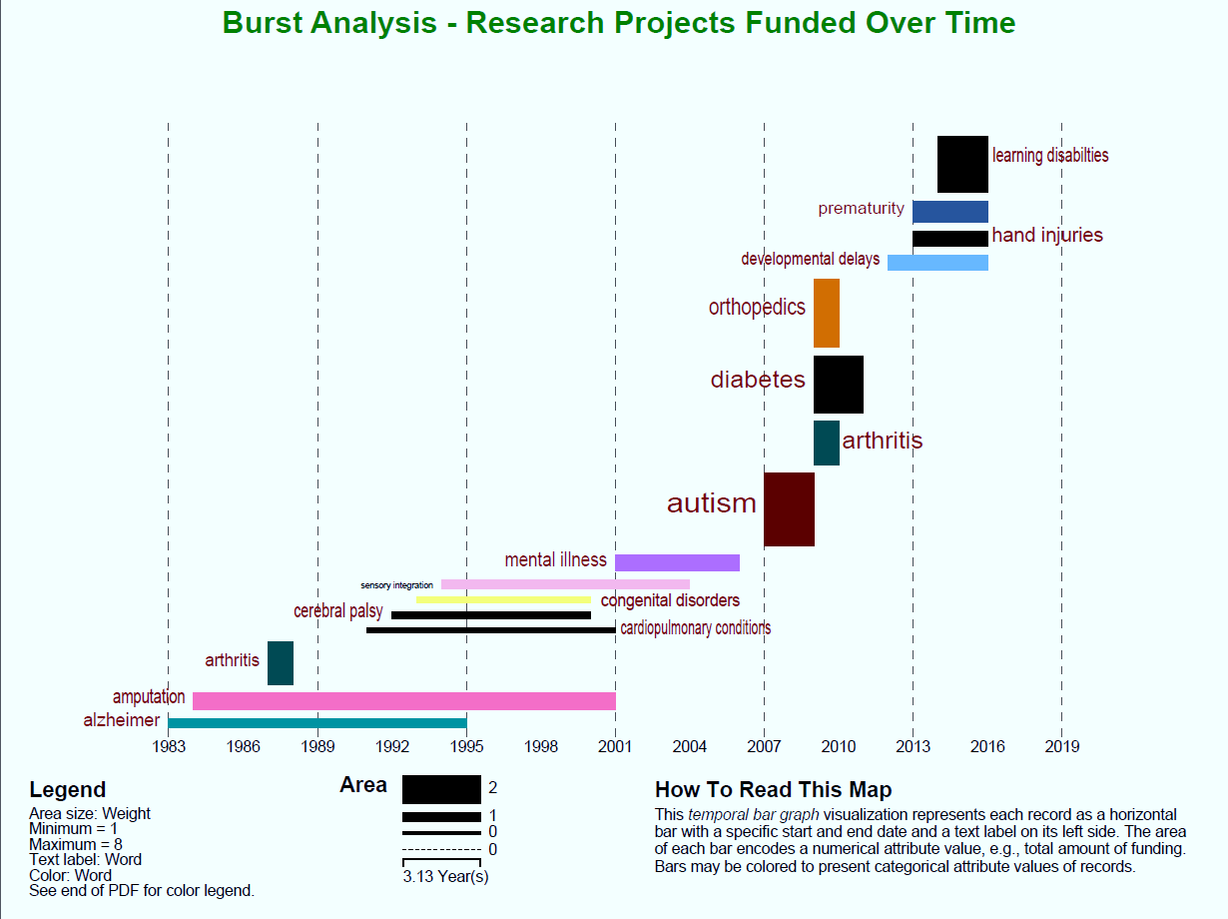
Temporal Visualization – Burst analysis of research projects funded over time

Slide 15
Network Analysis
Visualization Objective
The Bipartite Network map and Blondel Community Detection were used to identify networks of scientific experts and their expertise areas based on diagnosis, agenda and ICF categories presented in five cumulative time slices by seven years from 1982 to 2017 inclusively. The network analysis elicited insights into the existing scientific networks and helped to identify scientific leaders for specific expertise areas based on diagnosis and agenda categories relevant to particular research project.
How to Interpret
PI vs. Diagnosis Network:
Nodes represent primary investigators and respective diagnosis descriptions. Edges represent relationships between nodes. Nodes and Edges were color-coded based on similarities in research communities. Nodes , Node Labels and Edges were sized by number of references. Labels depicted PI name or Diagnosis and a number of references. Top 5 PIs with the most number of references colored according to the respective research community.
Diagnosis vs. Agenda Network:
Nodes were color-coded based on their belonging to Diagnosis or Agenda category and sized based on the number of references to respective projects. The nodes were sorted in descending order based on the number of references. Edges represented the number of associatoins between specific diagnosis and agenda items.

Slide 16
Cumulative Network of Diagnosis vs. Primary Investigators
1982-2017
Key Insights
For every time slice the number of nodes tripled from 18 in 1989 to 221 in 2017.
From 1982 to 1996 the research was concentrated on Amputations or limb loss, Other, and Dementia or Alzheimer's disease Diagnosis with M. Lowler and J.Rogers consistently leading the research in the respective areas, including on the Other Diagnosis.
From 2003 to 2017 the field of research expanded significantly and started moving to the areas of Autism spectrum disorders, lead by Teresa A. May-Benson, that is strongly connected to Sensory integration/processing disorders research community that was headed by Patricia Davies. The third largest, Stroke research community, is connected to the Other diagnosis by Kenneth Ottenbacher and is engaged in collaborations with Brain injury and disorders and Cerebral Palsy.
Two more dispersed communities were identified. The first consisted of the area of diagnosis associated with various body injuries such as Spinal Cord, Upper Extremities and Musculoskeletal injuries with Corey McGee and Mary Jane Mulcahey leading the field. The second emerging community consists of Mental illness, Diabetes and Cardiopulmonary conditions field lead by Christine Helfrich.

Slide 17
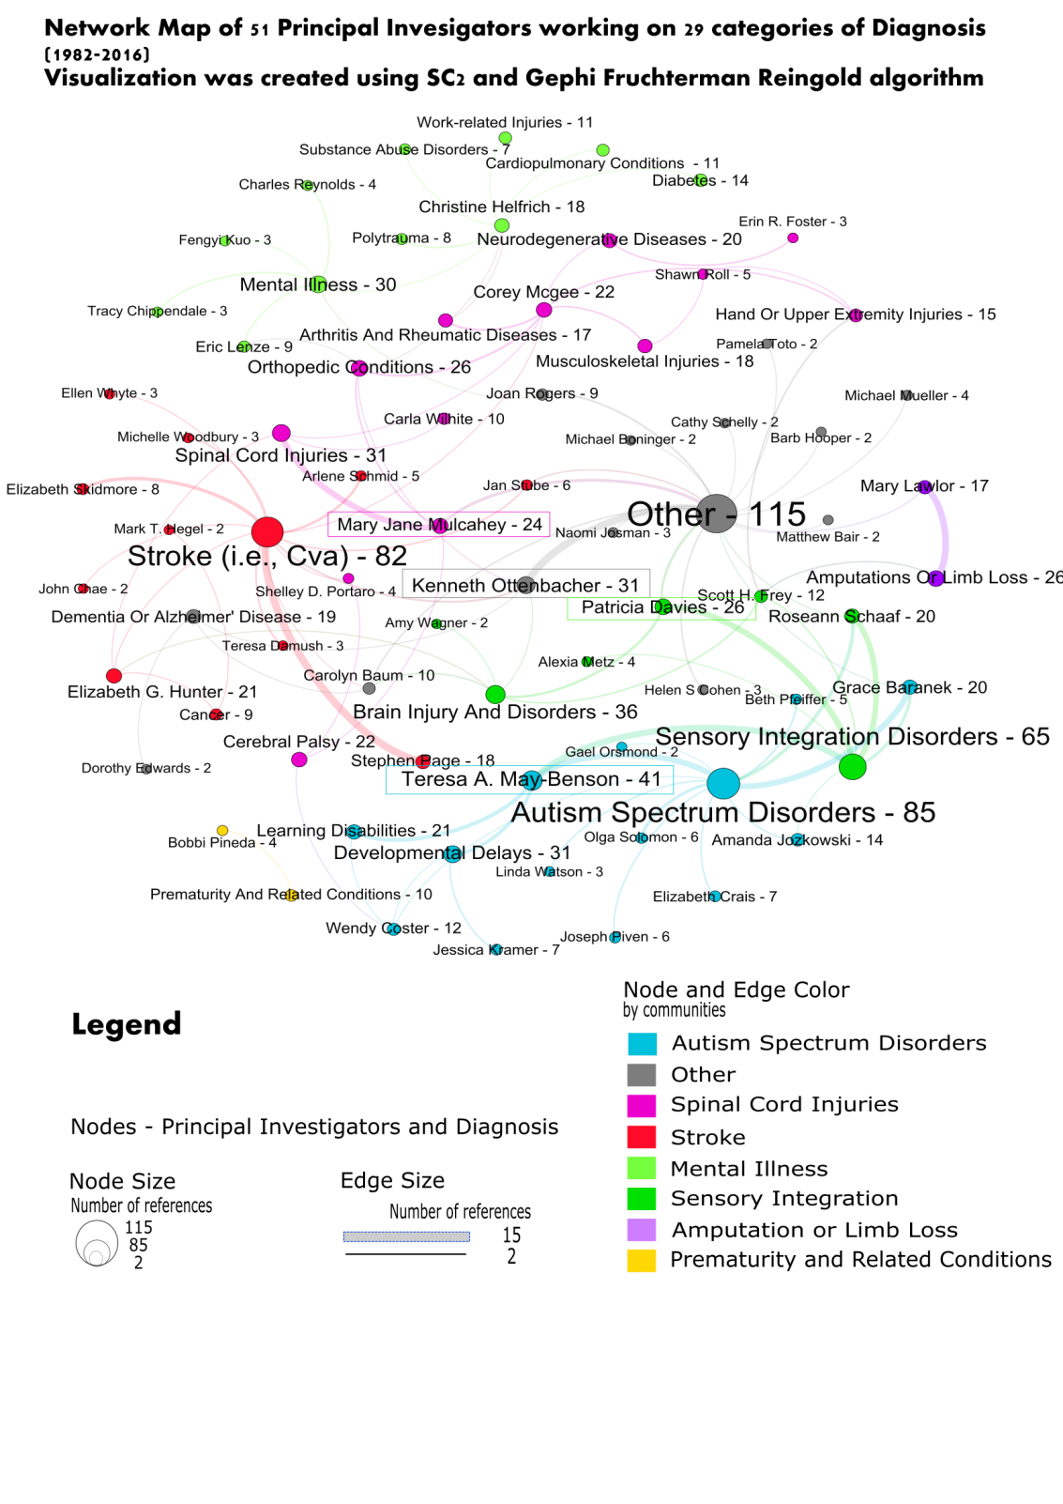
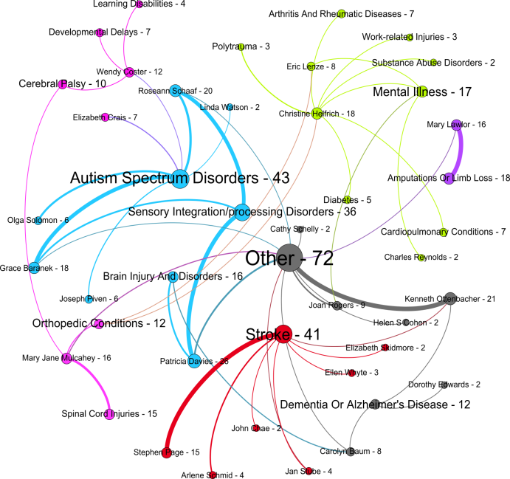
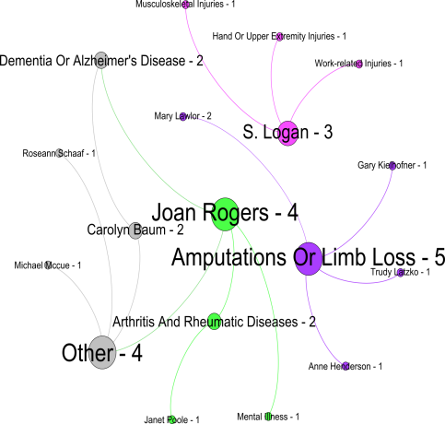
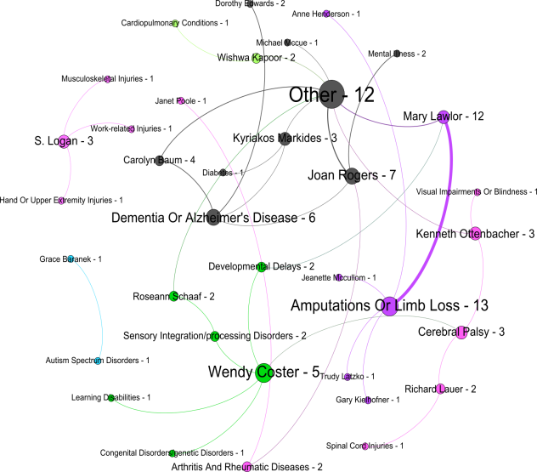
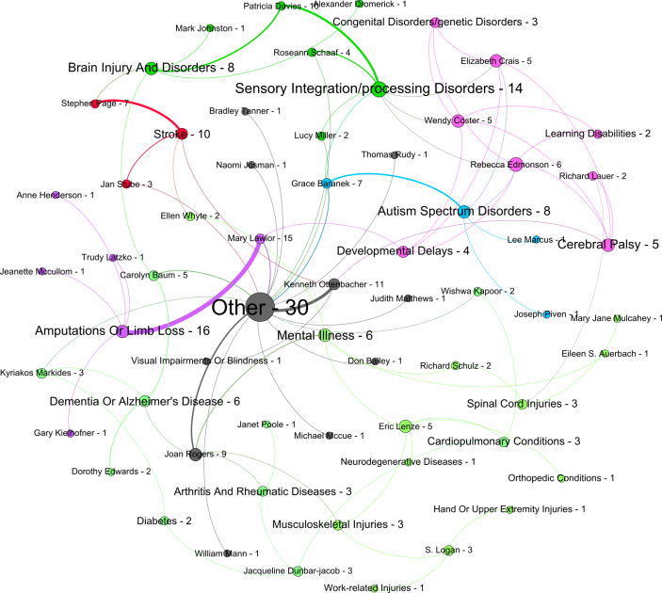
1982-1989
1982-2010
1982-1996
1982-2003

Slide 18
Cumulative Network of Diagnosis vs. Agenda
1982-2017
Number of references between agenda and diagnosis steadily grew from 7 in the period of 1982-1989 (to 22, to 75, to 148) to 278 in the period of 1982-2017. Started with only eight Diagnoses, the field significantly expended to 29 Diagnoses by 2017.
Basic Research, Assessment/measurement and Intervention-preventive Agendas were strongly represented by a majority of the associated research projects
After 1996 a new agenda item (Research Training) was introduced.
Initially, Basic Research, Assessment/measurement agendas were strongly linked with Amputations or limb loss, Other, and Dementia or Alzheimer's disease Diagnoses .
After 1996 Autism spectrum disorders, Sensory integration/processing disorders and Stroke Diagnoses associated with Intervention-preventive Agenda started playing prominent role in the OT community

Slide 19
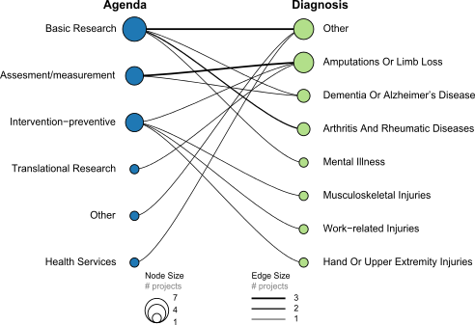
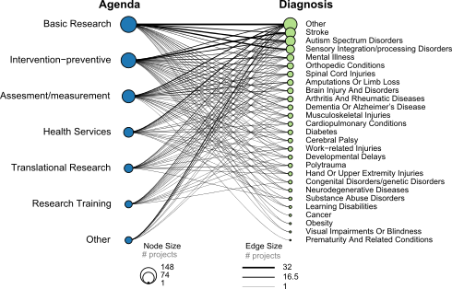
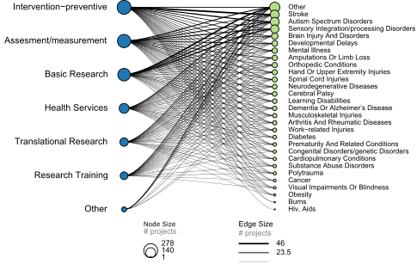
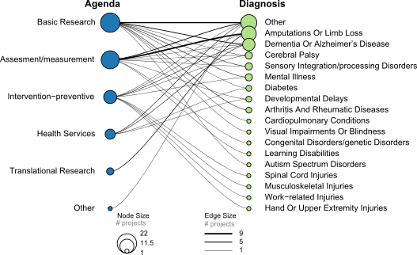
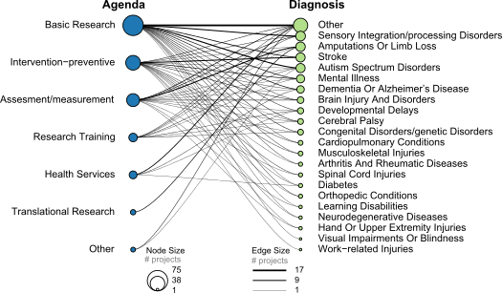
1982-1989
Cumulative Network of
Agenda vs. Diagnosis
1982-2017
1982-2010
Agenda Diagnosis
1982-1996
1982-2003

Slide 20
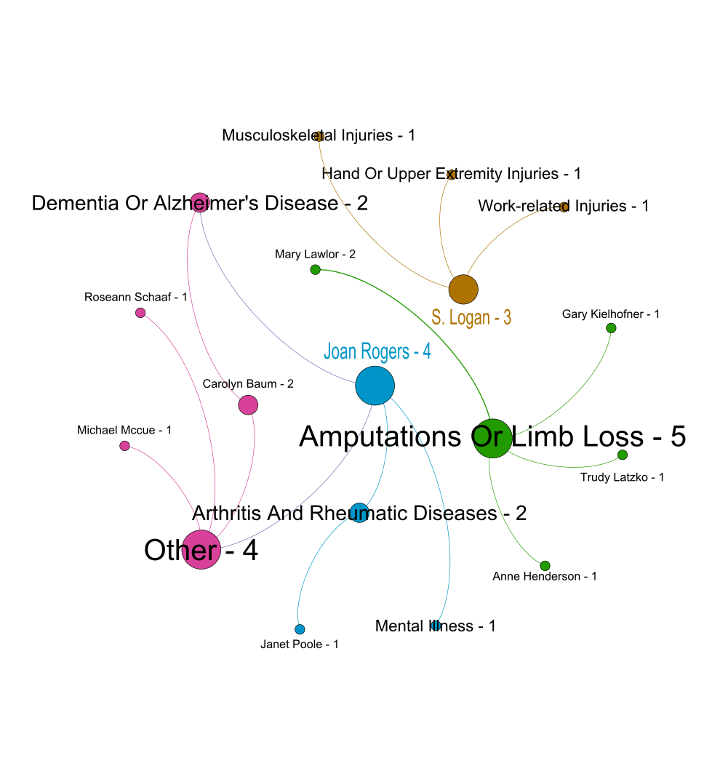
Cumulative Time Slice
1982-1989
Primary investigator -diagnosis
Agenda-diagnosis

Slide 21
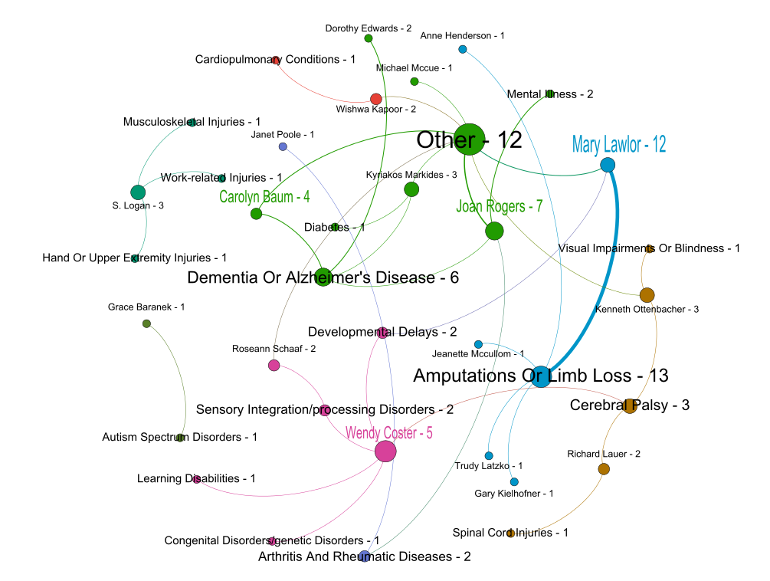
Cumulative Time Slice
1982-1996
Primary investigator -diagnosis
Agenda-diagnosis

Slide 22
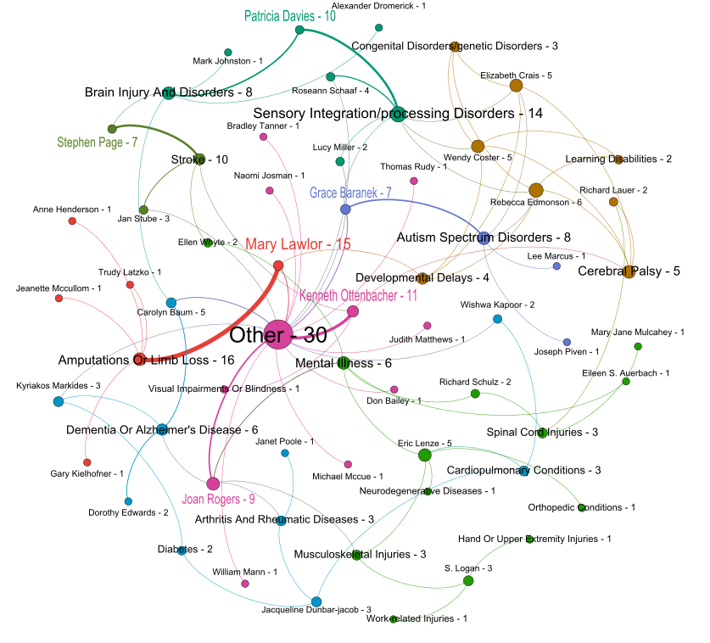
Cumulative Time Slice
1982-2003
Primary investigator -diagnosis
Agenda-diagnosis

Slide 23
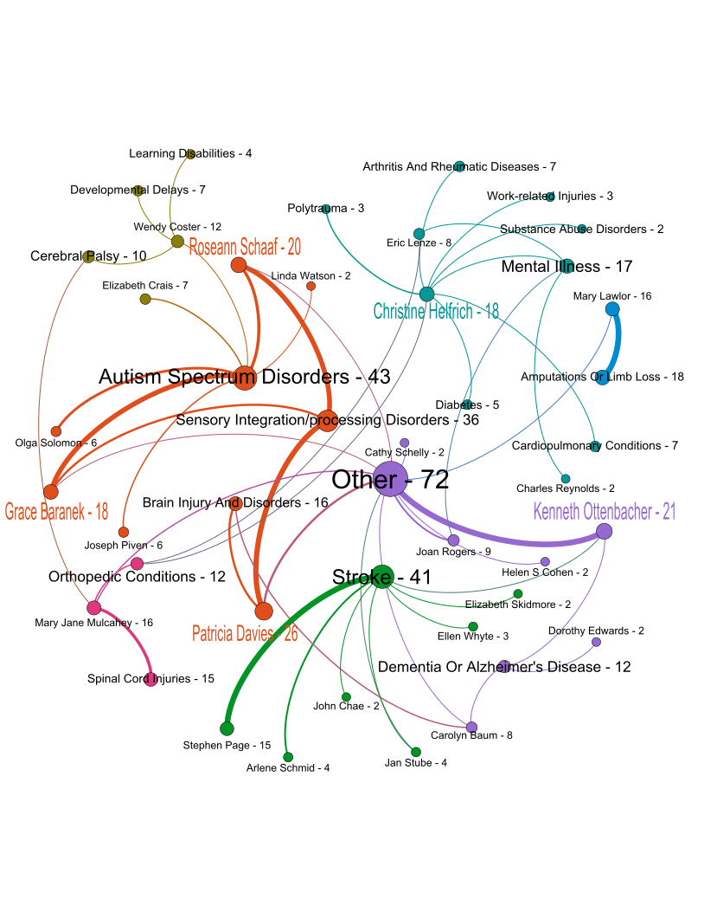
Cumulative Time Slice
1982-2010
Primary investigator –diagnosis
(2 and more projects only)
Agenda-diagnosis

Slide 24
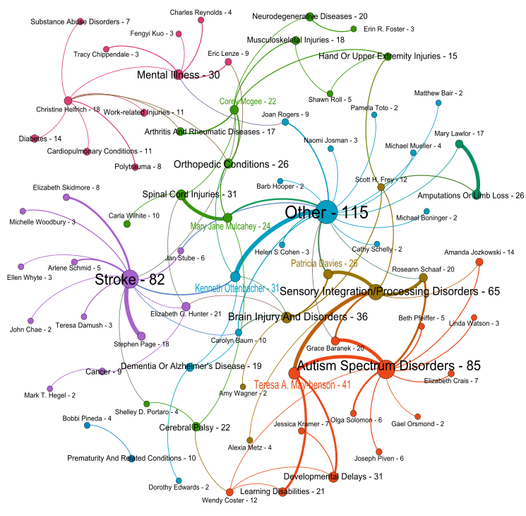
Cumulative Time Slice
1982-2017
Primary investigator –diagnosis
(2 and more projects only)
Agenda-diagnosis

Slide 25
Data Explorer
Visualization Objective
Provide an easy to view specific research data organized by location and topic. Copy the URL below into your internet browser (works on most newer browser versions)
https://public.tableau.com/shared/6YQXKHBHY?:display_count=yes
How to Interpret
See the following slides for instructions on using each visualization

Slide 26
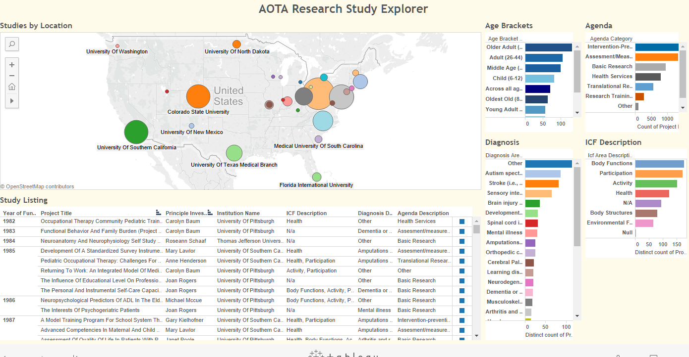
Study Explorer - How to Use
Click any colored shape to filter. Multiple Filters may be applied.
Click again to reset filter.
All views will update as filters are applied.
Hover on squares to see details of a study.

Slide 27
Limitations of Analysis
Profile data was considered unreliable and not used in analysis.
Institution locations were not specified. These were determined by geocoding based on the main location of the institution. This may not be the most accurate method.
Data does not reflect all research done in this area.
The purpose of this analysis was limited to envision the potential of visualization for occupational therapy research data, identify the strengths and weaknesses of the current database, and propose recommendations for improving the research database to support future visualizations.

Slide 28
Problems surfaced during validation
Burst analysis of the various diagnosis areas gets skewed as more and more research areas were funded over time. Burst analysis had to be re-created multiple times by adjusting Gamma & Density in order to make sure all the important diagnosis areas have been highlighted and persistence of funding is appropriately visualized. In order to further substantiate various diagnosis areas that were funded, and highlighted, a word cloud by decade has been created, using Tableau. This word cloud along with the burst analysis should clearly articulate how various various research areas have been funded over the decade, and also highlights how research areas evolved over time.
In order to do topical analysis, multiple visualizations were tested: Word Cloud, Tree Map, Network with many different layouts, GEM, Circular, Radial Tree, Kambada Kawai. Preprocessing step on keywords caused issues because stemming caused use to lose meaning in some of the terms. For example, the word “injury” became “injuri”, “Early Intervention” was one word but after tokenization became two words: “earli” and “intervent”. Similarly, “Spinal Cord” became Spinal and Cord . Due to this a lot of edges arose between the nodes which should not have been if we would have preserved the space between these kinds of words. I manually modified network file after executing Word Co Occurrence network so that word reflection is appropriate as encountered in the input file.

Slide 29
Problems surfaced during validation
There were some discrepancies in the locations of the nodes when comparing the geospatial map created using the parameters described earlier in Sci2 and Tableau. The issue seems to stem out from differences in zip codes since zip codes were not provided in the original data set from AOTF. A thorough google search was done to find the best zip codes. Geocoding was rerun on the updated zip codes using the Generic Geocoder. Longitude and latitude information was found on all 29 zip codes. The map was updated to show total funding amount, number of projects and number of researchers.
After initial visualization of PI vs Diagnosis in Gephi we realized that coloring nodes based on the bipartite network only depicts major PIs in the field and helps to identify the core types of the diagnoses. At the same time, the essential linkages between individual nodes (PIs and respective diagnoses) become quite obscure. In order to overcome this issue, we decided to provide a Blondel Community Detection analysis that helped to identify additional connections between various diagnosis and researchers.
In order to connect diagnosis descriptions with agenda we tested out several different visualization types including Fruchterman-Reingold with Annotation and Circular Hierarchy, however the Bipartite Network Graph proved to be the most precise and straightforward. The same type of time slicing on the Agenda-Diagnosis data helped to compare PI-Diagnosis with the similar time slice of the Agenda-Diagnosis data and to provide more insights into the nature of OT research during respective time slice.

Slide 30
Problems surfaced during validation
Getting client approval to use Tableau public was obtained with the condition that we will not include funding amounts. The data and visuals were updated to use the number of projects to size the proportional symbol map, and not total funding.
The final issue was setting the data up in a way that allowed filtering of multiple data items having multiple values. In our combined data set, we had combined multi-values into one column, which made for easier display of a study details. In order to allow for filtering, I added the original mapping tables that mapped each value to its study. Then it took a few attempts to get this relationship set up correctly in Tableau.

Slide 31
Challenges and opportunities
Most of the research projects covered multiple diagnosis areas. There are no specific fields to highlight how much of the funding went towards which area. So, it was difficult to use funding amount in temporal analysis.
Tokenization and Normalization of health care jargons is a big complex. Different set of stopwords had to be created.
Results of temporal analysis should be overlayed with various diseases that primarily hit during this period. Overlaying this disease information with AOTF research areas could explain if AOTF research projects were reactive or proactive in nature. Also, it will highlight how relevant research areas have been with the conditions/health care issues prevalent during those times.
Comparing AOTF research areas and funding amounts to other organizational funded research areas will explain if there is funding overload in some areas, or lack of funding. Such analysis will also highlight if the research areas are complementary or supplementary in nature with the industry.

Slide 32
Challenges and opportunities
The word cloud allowed to show all 470 keywords and frequency of words was being displayed through font size. However, it was challenging to show all those keywords in any other layouts. As a trade off- for the network analysis, I picked only keywords which showed up in the text at least 6 times for the Kambada Kawai layout.
I found a lot of spelling mistakes and related issues in data due to which Word Co-occurrence algorithm was not producing correct results and had to manually review all keywords. Use of existing stop words list along with standard tokenization technique with this healthcare dataset was a challenge so edited the network file multiple times
Not having an Undo capability in GUESS made things much more time consuming too, one single mistake made me redo all again. As a consolation, it was kind of a blessing in disguise in that I discovered a lot of its features. Down the road I see a need for industry specific stop words list and tokenization technique, GUESS tool improvement.

Slide 33
Challenges and opportunities
Since the geospatial map shows the potential collaboration links among the institutions, it would be helpful to show the network connections based on the keywords. However, trying to create the networks where there are three keyword columns with multiple rows per institution poses some complexities. In addition, the need to use other software like Photoshop, Adobe Illustrator and/or GIMP to overlay the network onto the map also adds to the complexity and is time consuming. The network overlay will certainly be an informational piece to add on the geospatial map for future visualization.
Due to creation of five time slices per network the main challenge was a presentation of significant part of the details without compromising the clarity of the images. Since number of the nodes (number of PIs and diagnoses) increased proportionally with every cumulative time slice, in order to minimize crowding of the nodes the last two slices for PI-Diagnosis were restricted to edges with weight >1. Respective isolated nodes were subsequently removed. In addition, we encountered that Gephi cannot provide persistent coloring of the blondel communities by modifying the color based on the percentage of the specific community size in relation to the other communities per time slice. We will continue investigating possibility to use specific colors per community to ensure their color consistency.
Furthemore, we will work on identifying links between diagnoses and ICF items and will add respective time slices to the previously created network maps.

Slide 34
Challenges and opportunities
In Tableau it took quite a while to get the layout of the dashboard in a way I felt was easy to use, and made the most efficient use of screen space. This took several hours. Now that I am more fluent in Tableau, I can more quickly add additional options, and will likely do this before submitting the final version.
Longer term, it would be useful to connect the Tableau template directly to the AOTA database, so that it can be used on an ongoing basis to easily examine submitted research data.
A general overall challenge was coordinating data and visual presentation across the team members. For instance, our Temporal analysis uses time slices by decade, and the network visualizations use 7 year time slices. We didn’t realize this issue until it was too late to fix for this submission. This is something we will try to harmonize better for the final presentation. We were able to coordinate a common PowerPoint template and color scheme so the final product presentation looks professional and make it easy to understand key insights from our work.

Slide 35
APPENDIX – Temporal Analysis

